Slide 1
SAM MASSIE CHAIR OF EXCELLENCE RESEARCH COLLEGE OF ENGINEERING
SENSOR DETECTOR APPLICATIONS FOR NUCLEAR MATERIALS
RESEARCH GRANT WITH
DOE/NNSA
PRAIRIE VIEW A&M UNIVERSITY
Prairie View, Texas
November 9, 2010

Slide 2
Prairie View A&M University is the second oldest institution of higher education in the state of Texas.
It had its beginnings in 1876, the first year of the Texas Constitution, of the common free school system and at the dawn of public higher education in Texas.
The University is situated on a 1,440 acre campus in Waller County, 30 miles northwest of Houston, Texas.
Though the University’s service area has generally extended throughout Texas and the world, the University’s target service area includes the Texas Gulf Coast Region.

Slide 3
The University's published enrollment for Fall 2009 was 8,608 students, which included over 2,000 graduate students.
Students enrolled at Prairie View come from throughout the United States as well as many foreign countries.

Slide 4
The Roy G. Perry College of Engineering has seven programs accredited by ABET (Accreditation Board for Engineering and Technology):
Chemical Engineering
Civil Engineering
Computer Science
Computer Engineering First Accreditation visit, Fall 2010)
Computer Engineering Technology
Electrical Engineering
Mechanical Engineering
Electrical Engineering Technology
In addition to the undergraduate degrees, the College of Engineering offers a
Masters of Engineering
Masters of Electrical Engineering
PhD degree in Electrical Engineering

Slide 5
The seven programs had and undergraduate enrollment of over 1000 students in the Fall semester of 2009 and a preliminary count increase for Fall 2010.
Six of the engineering programsare ABET accredited with the computer engineering program being accredited in the Fall 2010
The Roy G. Perry College of Engineering awarded 114 Bachelor’s degrees in these programs for the 2008-2009 academic year.

Slide 6
Research with DOE by the Sam Massie Chair of Excellence at Prairie View A&M University is in the area of nuclear detectors and sensors.
These sensor/detection systems are the critical tools for nuclear detection and National safety and security

Slide 7
Five Year Research Goal of Prairie View 2005-2010
Identification of sensors that are applicable to detection of nuclear material
Acquiring and testing existing sensors that are applicable to nuclear material detection and monitoring in any medium: air, water or soil.
Develop a compilation of experts in the field of sensor development and companies with specific manufacturing capabilities of ongoing sensor development.
Conduct preliminary laboratory evaluations and preliminary design
Design and development of sensor/detector system
Final Evaluation

Slide 8
PRAIRIE VIEW A&M UNIVERSITY SAM MASSIE RESEARCH TEAM
Dr. Ing Chang – Sam Massie Chair and Associate Professor of Mechanical Engineering. Expertise – Thermal Science and Air Pollution.
Dr. John Fuller – Principle Investigator and Professor of Electrical Engineering. Expertise – Power Systems/Digital systems design.
Dr. Warsame Ali, Assistant Professor Electrical Engineering with an expertise in power/control systems and computer hardware and software systems.
Dr. Pamela Obiomon, Associate Professor of Electrical Engineering joined the Massie team in the summer of 2009. Dr. Obiomon has an expertise in solid state electronics and computers

Slide 9
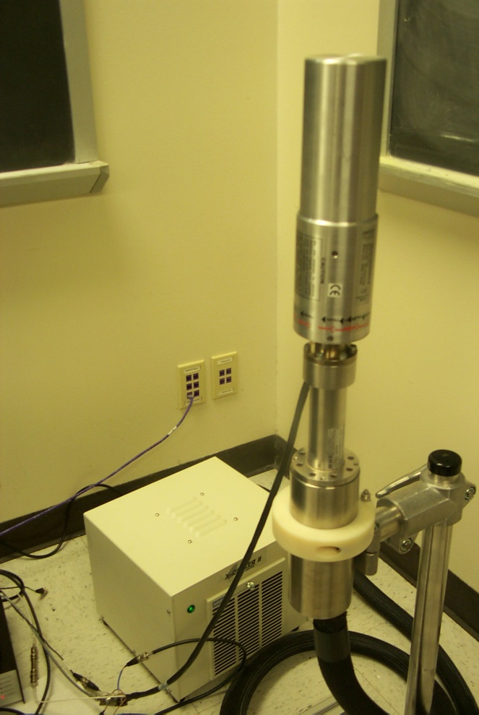
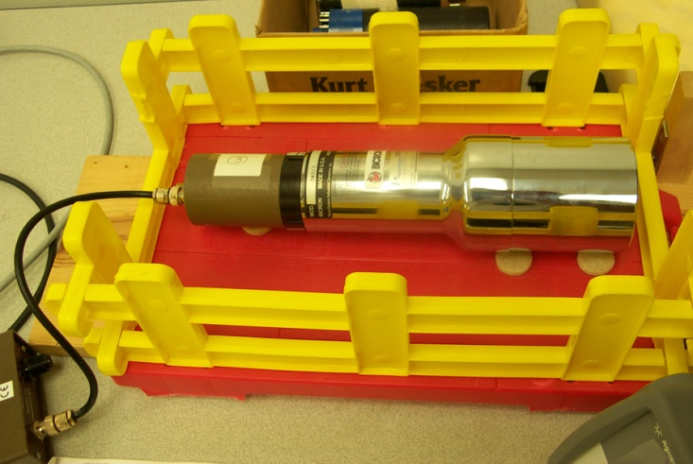
2005-2007
During the first two years of the funded effort the PV team experimented with various sensors, and evaluated their integration and application into nuclear detectors. Along with integration applicability to detector systems the PV team designed experiments to test sensors for detection of specific radiation signatures of special nuclear materials. In addition to researching traditional methods of nuclear detection, the team also investigated the integration of new technology into sensor evaluation and detection.
Germanium Detector
Sodium Iodide Detector

Slide 10
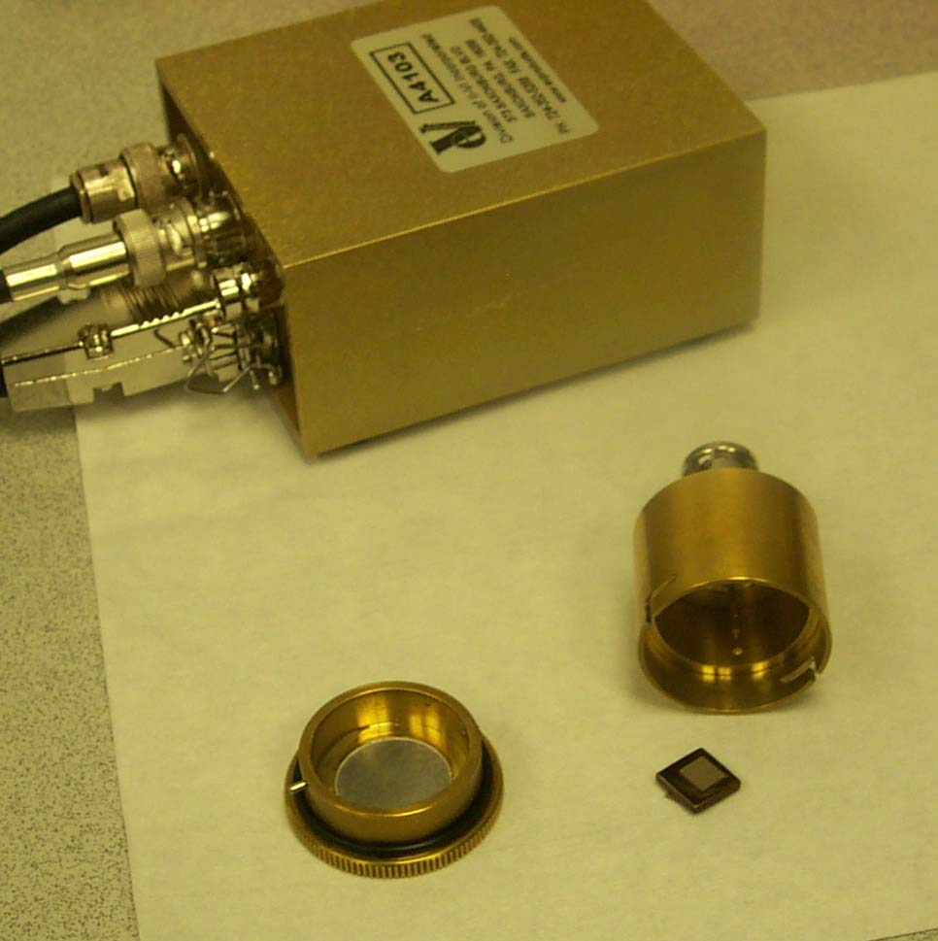
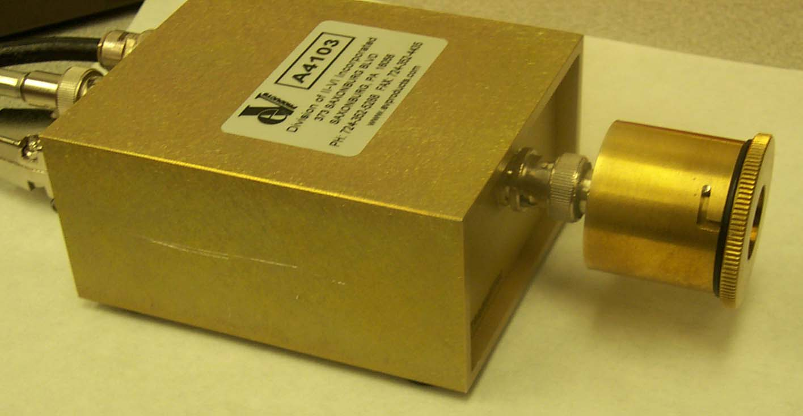
2007-2008
The third year of research was focused on the integration of the solid state sensors into a portable system. Initial system design was conducted using the LabView software package available at Prairie View A&M University. The PV team was able to integrate the solid state sensor to a desktop computer via means of an A/D converter.
Cadmium Zinc Telluride (CZT) Sensor

Slide 11
Concentrated experimentation on Cadmium Zinc Telluride (CZT) crystals purchased from EV Products. The PV Team analyzed the electrical and radiation characteristics of the CZT detectors to improve signal extraction and spectral interpretation of the data. Conducted IV tests on the crystal.
Used National Instruments Labview software package for nuclear sensor/detector signal analysis. This system provides evaluation tools in a software package, eliminating the need of purchasing expensive hardware for signal analysis.

Slide 12
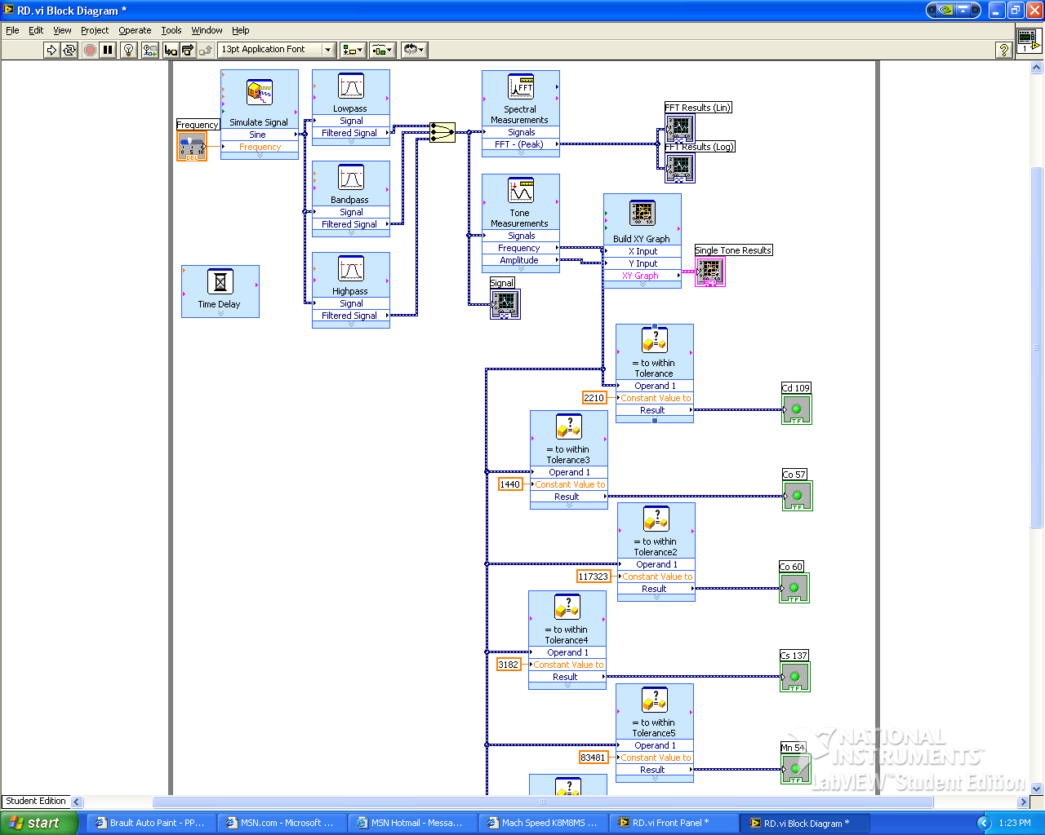
LabView Simulation

Slide 13
2008-2009
The fourth year of research effort(2008-2009) the PV team continued research on a microprocessor driven portable device which required the development of an interfacing device and the necessary software to operate and evaluate the device
Pre Amp
CZT Detector
CZT Detector
Pre Amp
Analog I/O
Amp
HV VDC
Amp
LabView
HV VDC
Oscilloscope
Gnd
Gnd

Slide 15
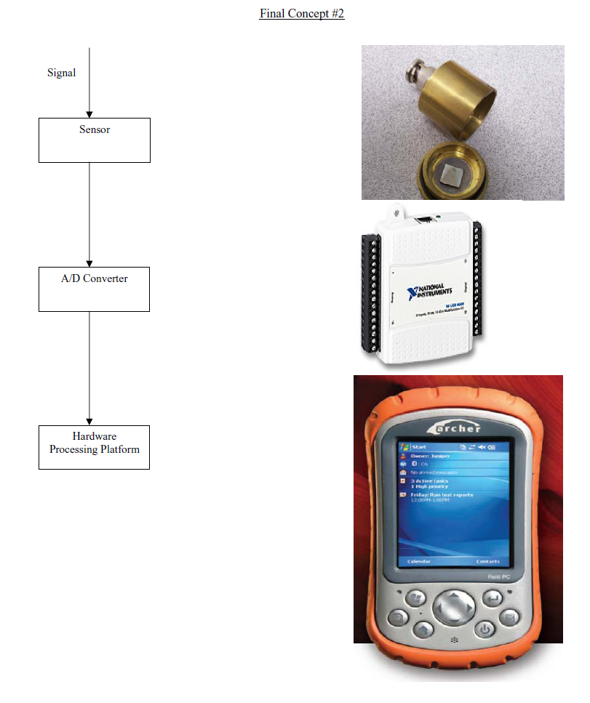
2008-2010
Field PC detection system

Slide 16
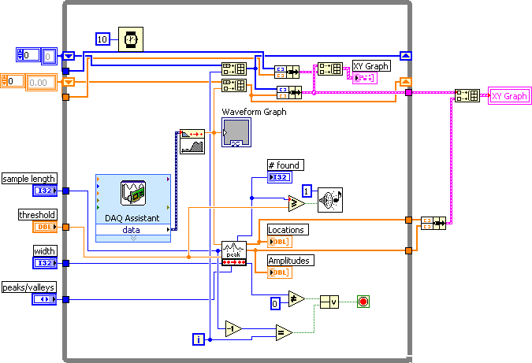
LABVIEW PEAK DETECTOR
The LabView peak detector has a signal input from the preamplifier that flows through an external A/D converter and enters the program through a DAQ assistant as shown above. The program detects peaks and displays the number of peaks within a specified period of time by a counter as shown in the figure on the next slide.

Slide 17
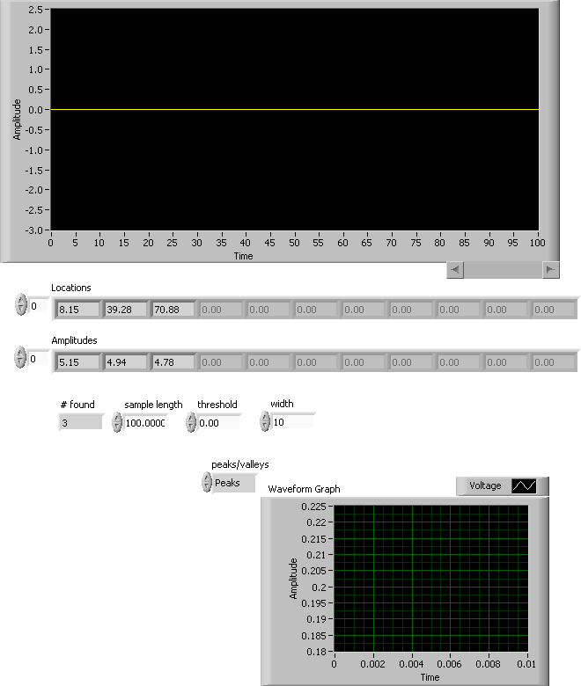

Slide 18
RESEARCHER PUBLICATIONS
Warsame H. Ali, Penrose Cofie, Jian Zhang, and Vaman, “Digital Cascaded Design for MIMI Analog Systems with Multiple I/O Delays” ASME 2010, Approval pending
Suxia Cui, John Fuller, Pamela Holland-Obiomon, and Warsame H. Ali, “Educate New Generation on Nuclear Technology through Collaborating Engineering Project”, 2010 ASEE Northeast Section Conference, Wentworth Institute of Technology, Boston, MA, May 7, 2010 – May 8, 2010.
Northern, J., Fuller, John, ”Project Based Learning for a Digital Circuits Design Sequence at HBCU’s”, Northern, Fuller, ASEE Conference, Hawaii, Summer 2007.
Obiomon, P., Fuller, J., “Radiation Effects on Non-Volatile Memories,” NASA Office of Logic Design, 2006 MAPLD International Conference, Washington, D.C. 2006 September 26-28, 2006

Slide 19
Student Publications
“Acquisition System for a Nuclear Radiation Detection System,” by Preston Perry and Leslie Beloney, April 2009
“Hand-held Nuclear Detection Device”
By Karim Diop, Magine Rideau, David Rougely and Morgan Warren, December 2009

Slide 20
Related Research
Air Force Office of Scientific Research Development of Energy Laboratory in Electrical and Computer Engineering $81,200 Sept 30,2008 – Sept 29, 2009
Department of Education Title 3 program Development of Ph.D. program in Electrical Engineering $250,000 2009- 2010

Slide 21
OUTREACH INITIATIVES
Massie Professors continued to work with the secondary school students in summer workshops and were very active in teaching fundamental engineering concepts and mathematics.
Workshop for High School Math and Science Teachers.
Workshop for High school Counselors

Slide 22
Summer Workshop for High School Math and Science Teachers
Second Session (July 26– July 30)
 | Monday July 26 | Tuesday June 27 | Wednesday June 28 | Thursday July 29 | Friday July 30
8:00-11:50 | (8:00-9:00) Registration | (8:00-8::20) Preview of the Day’s Activities Dr. Ali | (8:00-8::20) Preview of the Day’s Activities Dr. Ali | (8:00-8::20) Preview of the Day’s Activities Dr. Ali | (8:00-8:10) Preview of the Day’s Activities Dr. Ali
 | (9:00-10:00) Welcome, Introductions and Week Schedule Drs. Attia, Obiomon. Ali, and Kirby Registration | (8:30-9:20) Basic Circuits I. Color Codes and Design Circuits (Simulation) Dr. Ali | (8:30-9:20) Engineering Education for the 21st Century Dr. Attia | (8:30-9:20) Electronic circuits using NI ELVIS Dr. Ali | (8:15-9:00) Discussion on use of technology to Engage Students. Group Discussion Dr. Fuller/ Dr. Ali/Dr. Obiomon
 |  |  |  |  | (9:00-9:45) Career Education for Placement Mrs. Glenda Jones
 | (10:00-11:30) Tour of Roy G. Perry-College of Engineering Labs. Dr. Attia | (9:30-10:30) Basic Circuits I. Color Codes and Design Circuits (Implementation) Dr. Ali | (9:30-10:45) Math Applications for Engineers Dr. Obiomon | (9:30-10:45) Infinity Design Project. Dr. Obiomon | (9:50-10:20) Survey Dr. Ali
 |  | (10:30-11:45) Computer Applications for Engineers Dr. Fuller | (10:50-11:45) Laboratory experiments to obtain insights in applications of Algebra, Geometry, and Calculus on Engineering. Dr. Fuller | (10:50-11:45) Infinity Design Project. Dr. Obiomon | (10:30-11:45) Discussion of the workshop benefits Group Discussion Dr. Attia/Dr. Ali/Dr. Obiomon
11:45-12:50 | BREAK | BREAK | BREAK | BREAK | BREAK
1:00-4:50 | (1:00-2:30) Electromagnteic Interferences David Momoh | (1:00-2:50) MATLAB software demonstrations with engineering applications Dr. Attia | (1:00-2:50) Project Design. Dr. Olasupo/Faruk | (1:00-2:50) Lego Project. Dr. Olasupo/Dr. Ali | Closing Ceremony. Dean, & Dr. Kirby
 | (2:30-4:50) Mixed Signal Testing Awad, Emad | (3:00-4:50) Electronic Circuits Dr. Olasupo | (3:00-4:50) Project Design. Dr. Cofie | (3:00-4:50) Project Design. Dr. Cofie

Slide 23
Future Research
Continue development of portable nuclear detection device
Design of a concentrator mechanism

Slide 26
The following tasks were originally planned and have been completed or are ongoing from the first year of the research effort.
August 1, 2005 – July 31 2006 (October 2005-July 2006)
Identification of sensors that are applicable to nuclear detection and other existing sensors that could be applied to nuclear detection or other applications related to nuclear detection.
Develop a compilation of experts in the field of sensor development and companies with specific manufacturing capabilities of ongoing sensor development.
Secured laboratory testing facility within the PV Engineering Complex and structured the laboratory for sensor and detector experimentation.
Conducted preliminary laboratory evaluations of various sensors and detector systems.
The PV Team hosted the quarterly meeting of the Sam Massie Chairs at the Crowne Plaza Hotel in Houston, Texas on June 22-23. The group made a visit to the sensor detector lab at PV.

Slide 27

Detectors/Sensors Identified and Tested
Sodium Iodide Detector

Slide 28
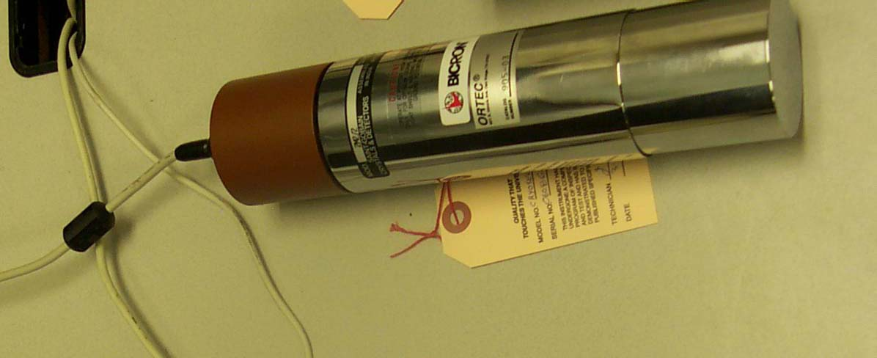
Sodium Iodide Detector

Slide 29

Germanium Detector Installed and tested a High Purity Germanium (HPGe) gamma ray spectroscopy system. This is a high sensitivity, high resolution solid state detector system which is currently the industrial standard in the nuclear industry. One of the limitations of HPGe detectors are their need for a very low temperature (liquid nitrogen) for operation

Slide 30
CdZnTe Detector and Sensor
A most promising of the room-temperature semiconductor detectors is Cadmium
Zinc Telluride (CZT). This material has a high average atomic number and high resistivity. These properties give this material good radiation absorption characteristics and low leakage currents
which are favorable for low noise/high energy resolution applications.

Slide 31
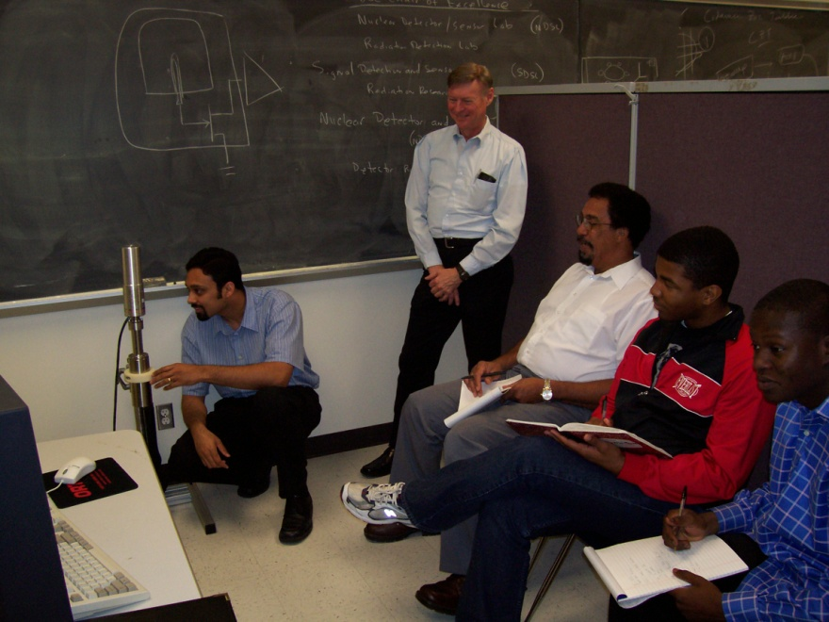
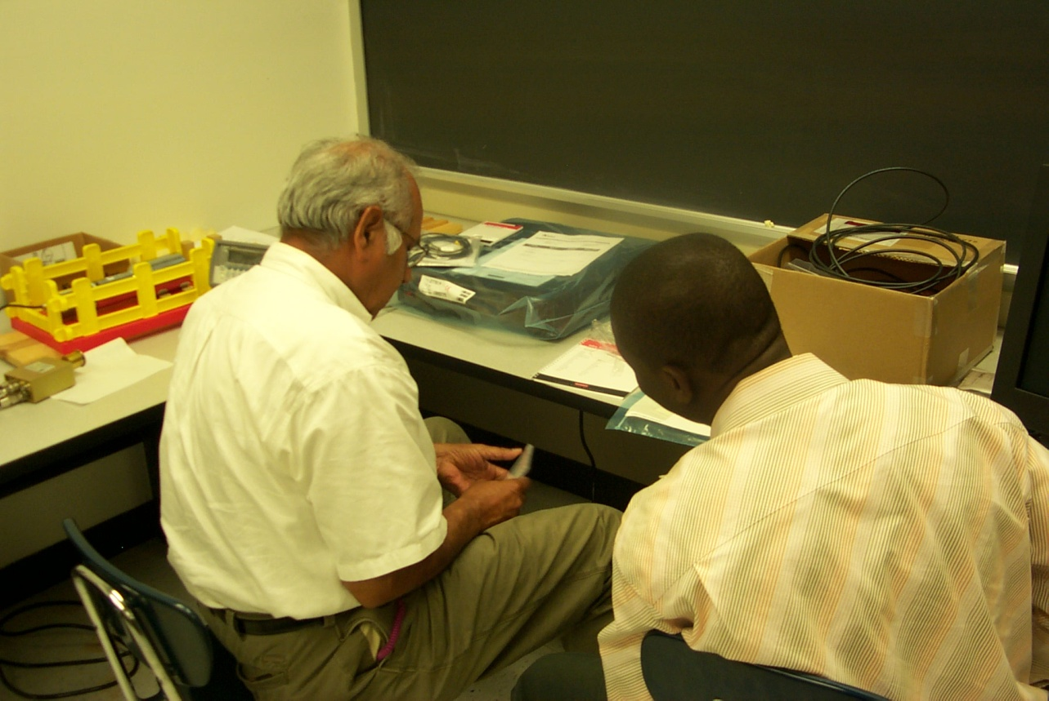
PV Team in Detector/Sensor Laboratory
Installing new Germanium Detector System with guidance from Joe Lasseter of Ametek Systems.
Mr. Ramesh Dwivedi with student Temitayo Femi-Fowode evaluating new Keithley 237 high voltage source and CZT detector.

Slide 32
The following tasks were originally planned and are being carried out during this second year of the research effort.
August 1, 2006 – October 20, 2006 (present)
The PV Team is continuing the analysis and experimentation with Cadmium Zinc Telluride (CZT) crystals purchased from EV Products Incorporated in Saxonburg, Pennsylvania. The Team is analyzing the electrical and radiation characteristics of the CZT detectors to improve signal extraction and spectral interpretation of the data. Conducted IV tests on the crystal.
Using the Labview software package in nuclear sensor/detector signal analysis. This system provides evaluation tools in a software package, instead of purchasing expensive hardware for signal analysis.
Modeling HPGe and CZT detector in Monte Carlo radiation transport code MCNP. This effort is focused to study detector-source geometry, material sensitivity, and new material characterization. The effort is currently being performed by Dr. Aghara and a student.

Slide 33
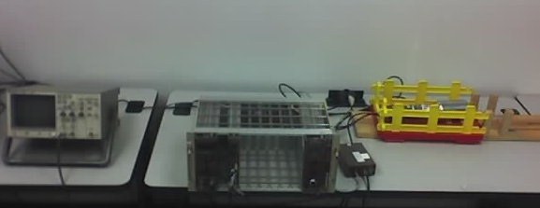
Pre Amp
CZT Detector
CZT Detector
Pre Amp
Analog I/O
Amp
HV VDC
Amp
LabView
HV VDC
Oscilloscope
Gnd
Gnd

Slide 34
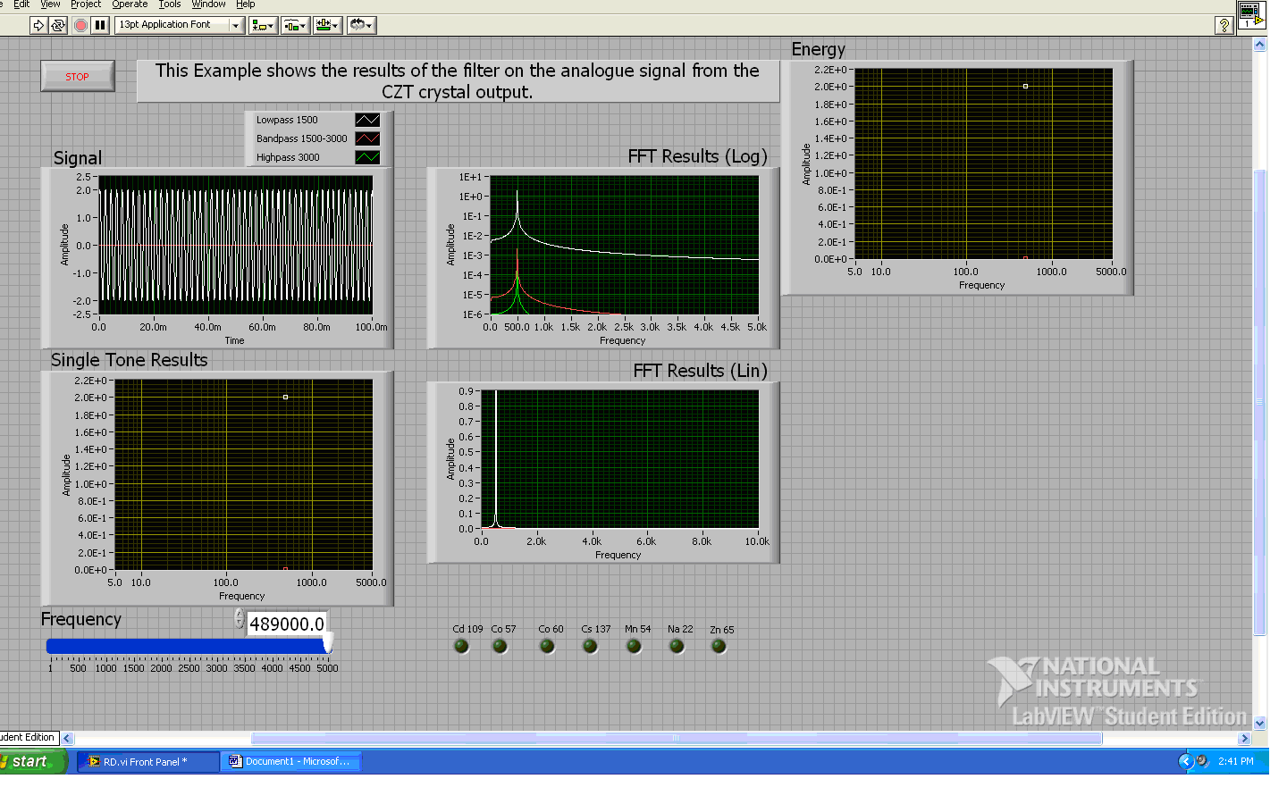
LabView Simulation
Signal – The actual signal from the detector is detected at 20 MHz. This signal is too fast for the input circuitry.
Single Tone Results – The tone results will represent the magnitude and pulse count of the radiation source. The magnitude will determine the radiation source and the pulse count will represent the radiation strength.

Slide 35
LabView Simulation

Slide 36
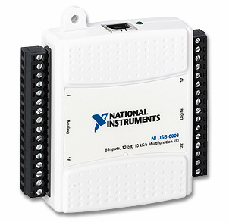
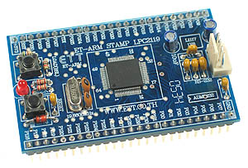
Analog I/O Card
Arm-Stamp (Microprocessor)

Slide 37
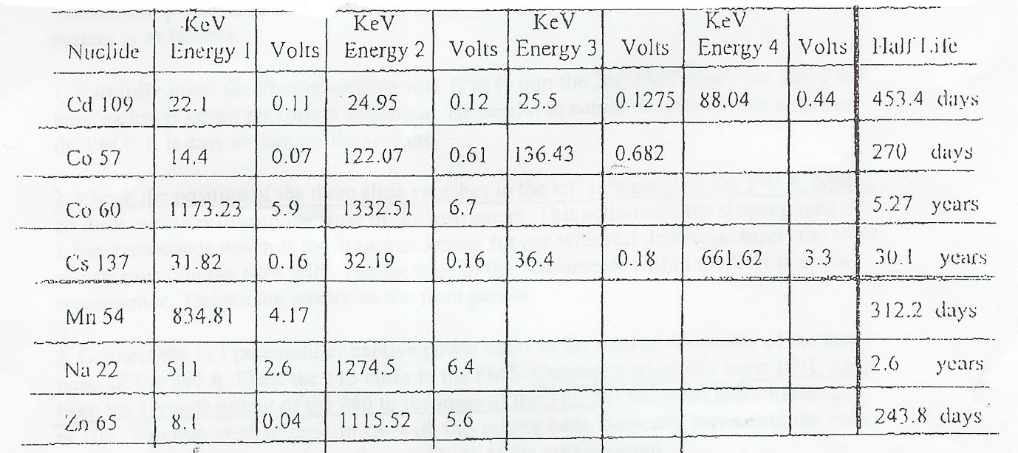
Detector/Sensor Detecting
All nuclear materials emit radiation. Specific nuclides can be identified by their KeV energies

Slide 38
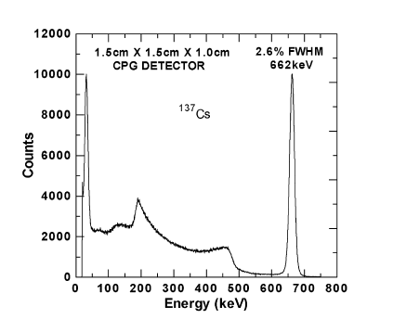
IEEE TRANSACTIONS ON NUCLEAR SCIENCE, VOL. 51, NO. 5, OCTOBER 2004 2443
Characterization of the Charge Transport Uniformity
of CdZnTe Crystals for Large-Volume
Nuclear Detector Applications
Stephen A. Soldner, Member, IEEE, Alex J. Narvett, David E. Covalt, and Csaba Szeles

Slide 39
Integration of Nuclear Science into the Engineering Curriculum
Courses previously taught
Introduction to Nuclear Engineering
Energy Systems
Hazardous Waste Management
New course for Spring 2007
Radiation Detection and
Instrumentation
Laboratory space is available for experimentation via means of the Sensor/Detector Laboratory, funded by NNSA research
Eventually develop a Nuclear Engineering Concentration for undergraduate and graduate students

Slide 40
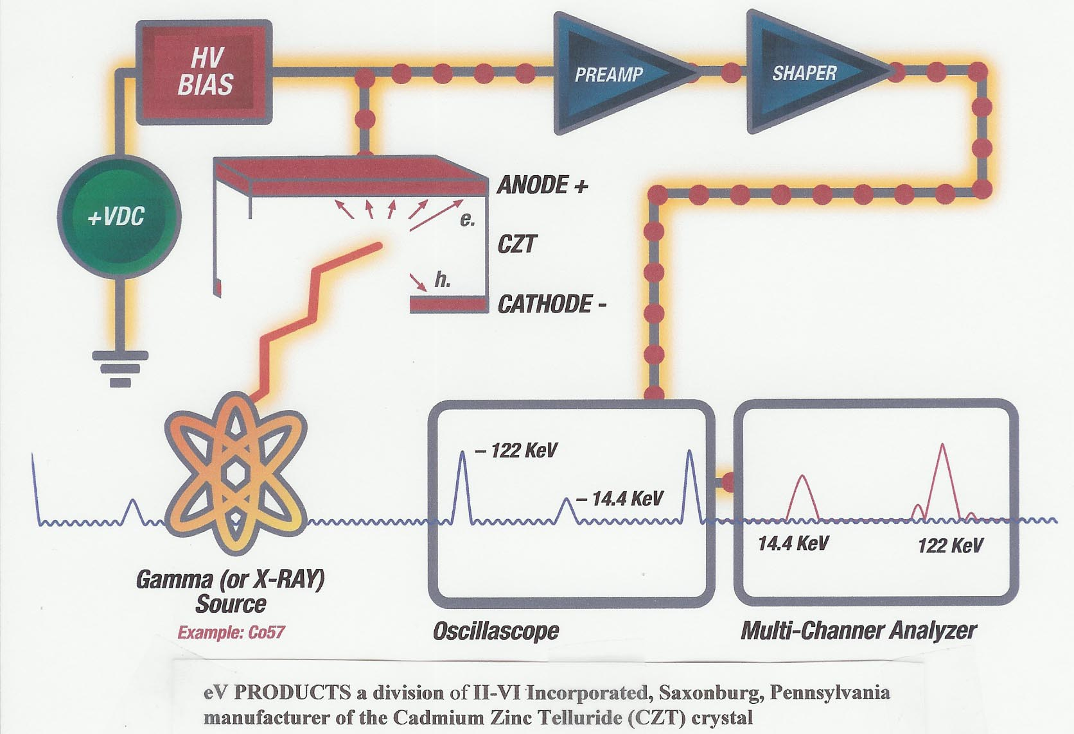
Testing for KeV Energies

